Slide 1
Chemistry Basics
All of the matter in the universe (what we call “stuff”) is made of just about _______ different kinds of _______.
Everything in your world is made up of simple ___________________ of these basic building blocks called atoms.
Chemistry is the study of how these atoms __________ and the products they _______.

Slide 2
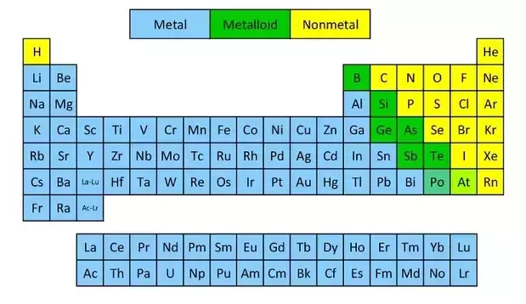
The Periodic Table
Contains almost all of the information about all of the elements on one page.

Slide 3
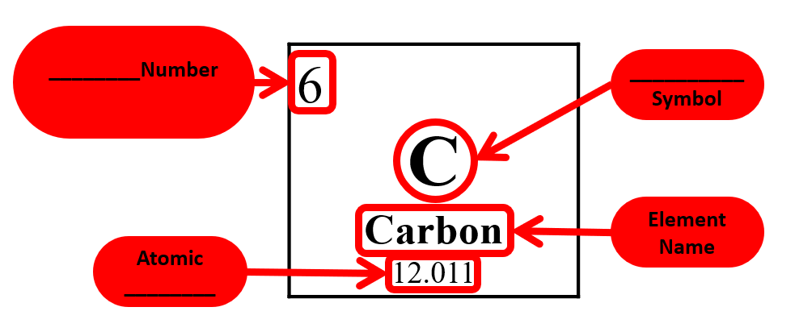
Reading The Periodic Table
Each box on the periodic table represents a different element
It contains vital information about the element
Note: Always _______ the Atomic Number to a whole number. e.g. _______

Slide 4
